Slide 1


Investigating and Predicting Alcohol
Misuse Risk Among American
College Students
Jonah Watson
Supervisor: Yasser Alginahi
April 7, 2025
Notes:
specify majors
line spacing 1.15 and 12 after for each slide

Slide 2
Presentation Content
Introduction & Motivation
Project Overview
Literature Review
Methodology
Model Building & Testing
Results & Discussion
Conclusion & Connection to Ribbons of Excellence
References
Acknowledgements

Slide 3
Introduction & Motivation
Alcohol is known to be consumed frequently by American college students, and students need to understand the associated risks
This research serves to raise awareness on what factors contribute to elevated risk of alcohol misuse and related issues

Slide 4
Introduction & Motivation
Alcohol is a central nervous system depressant, slowing brain activity, and potentially changing mood, behavior, and self-control
It reduces overall brain function, impairing thinking and reasoning as well as muscle coordination and physical control
The nuanced effects of alcohol vary from person to person based on frequency of drinking, number of drinks, age, sex, genetics, if a family history of drinking problems exists, and overall health

Slide 5
Introduction & Motivation
Binge drinking is excessive drinking considered to occur when someone has a Blood Alcohol Concentration (BAC) of 0.08% or greater
This typically occurs after 5 or more drinks within a few hours for a man, and 4 for a woman
Binge drinking increases the risk of injuries, violent behavior, vehicle accidents, and overdose
In 2023, 12,429 people died from drunk driving incidents in the United States alone, which averages one death by drunk driving every 42 minutes
Notes:
.

Slide 6
Introduction & Motivation
Heavy alcohol use is defined as binge drinking 5 or more times in a month
This counts as 5+ drinks on any day or 15+ drinks per week for men, and 4+ drinks on any day and 8+ drinks per week for women
Heavy alcohol use increases the risk of certain cancers, liver and heart disease, alcohol use disorder (AUD) and other alcohol-related and general health issues
Notes:
Heavy alcohol use counts as 5 or more drinks on any day or more than 15 drinks per week for men, or 4 or more drinks on any day or more than 8 drinks per week for women,

Slide 7
Literature Review
A comprehensive review of alcohol-related literature was created before performing analysis and modeling
This will be discussed further later in the ”Results & Discussion” section
Main ideas:
  Alcohol consumption patterns are often influenced by mental health issues, participation in Greek Life, and drinking norms of friends and family
  Alcohol misuse often leads to negative mental health outcomes and risky behaviors and choices, with some being illegal

Slide 8
Methodology
Data was purchased from the ACHA-NCHA spring 2024 survey (103,639 survey responses from American college students)
The process of working through the data is shown on the next slide
Notes:
Clarify what ACHA-NCHA means

Slide 9
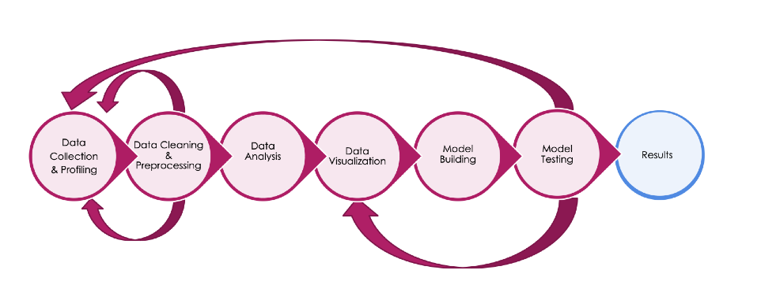
Methodology (Pipeline)
Nearly all of the processes in the pipeline were completed using the Python programming language and its libraries

Slide 10
Methodology
(Data Collection & Profiling)
The data represents 103,639 American college students, representing 154 higher education institutions
The next two slides will display tables of the features that were most essential to the upcoming data analysis and modeling section

Slide 11
Methodology
(List of Most Important Variables)
Variable | Description
N3Q1 | Self-reported overall health rating
N3Q48 | Self-reported overall stress level (last 30 days)
N3Q65A2 | Has the student been diagnosed with ADD/ADHD?
N3Q65A3 | Has the student been diagnosed with alcohol or drug abuse/addiction?
N3Q65A7 | Has the student been diagnosed with anxiety?
N3Q65A15 | Has the student been diagnosed with depression?
N3Q65A19 | Has the student been diagnosed with gambling disorder
N3Q65A28 | Has the student been diagnosed with insomnia?
N3Q65A31 | Has the student been diagnosed with OCD?
N3Q65A33 | Has the student been diagnosed with PTSD?
N3Q65A35 | Has the student been diagnosed with sleep apnea?

Slide 12
Methodology
(List of Most Important Variables Cont’d)
Variable | Description
N3Q77A | Is the student a member of a fraternity or a sorority? (Greek life)
N3Q77B | Does the student live in a fraternity or a sorority?
N3Q80 | What is the student’s GPA?
RKESSLER6 | Kessler-6 score for mental distress (0-12 negative for mental distress, 13-24 positive)
RULS3 | UCLA Loneliness Scale (3-5 negative for loneliness, 6-9 positive)
RSBQR | Suicide Behavior Questionnaire-Revised Screening Score (3-6 negative for suicidal behavior, 7-18 positive)
DIENER | Diener Flourishing Scale – Psychological Well-Being (PWB) Score (8-56), with higher scores reflecting higher PWB.
CDRISC2 | Kessler-6 score for mental distress (0-12 negative for mental distress, 13-24 positive)
ALCOHOLRISK | Risk of alcohol misuse-a score of 0-10 indicates low risk, 11-26 indicates moderate risk, and 27-39 indicates high risk

Slide 13
Methodology
(Data Cleaning & Preprocessing)
Several rounds of data cleaning were performed
These rounds of cleaning included...
  Removal of irrelevant variables
  Removal of duplicate rows
  Recoding of categorial answers into numerical answers (for analysis)
The next few slides will display relevant demographic information

Slide 14
Methodology
(Key Demographics)
Sex | Representation
Female | 72,586 (70.9%)
Male | 29,775 (29.1%)
Average Age | 23.4
Year in School | Representation
Freshman | 20,832 (20.7%)
Sophomore | 17,239 (17.1%)
Junior | 20,600 (20.5%)
Senior | 15,796 (15.7%)
5th+ Year Undergraduate | 4,779 (4.7%)
Master’s Student | 13,646 (13.6%)
Doctorate Student | 8,198 (8.1%)

Slide 15
Methodology
(Key Demographics Cont’d)
Race/Ethnicity | Representation
White | 62,857 (60.6%)
Hispanic/Latina/Latino | 19,120 (18.4%)
Asian/Asian American | 17,425 (16.8%)
Black/African American | 6,920 (6.7%)
Biracial/Multiracial | 5,183 (5%)
Other (includes Pacific Islander, Middle-Eastern, etc) | 4,954 (4.8%)
Approximate GPA | Representation
A | 63,718 (63.7%)
B | 29,899 (29.9%)
C | 5,841 (5.8%)
D/F | 551 (0.6%)

Slide 16
Methodology
(Alcohol-Related Questions)
Question | Never | Once or Twice | Monthly | Weekly | Daily/Almost
Frequency of alcohol use in the last 3 months | 5.9% | 21.3% | 17.8% | 21.8% | 1.7%
Have you experienced health, social, legal, and/or financial problems from alcohol? | 55.6% | 4.8% | 1.1% | 0.7% | 0.2%
Question | Never | Yes
Has anyone expressed concern about your alcohol use? | 61% | 7.2%
Have you ever tried and failed to control/cut/down/stop your alcohol consumption? | 62.5% | 5.8%
Question | 0x | 1x | 2x | 3x +
In the last two weeks, how many times have you binge drank? | 23.7% | 10.6% | 5.3% | 4.6%
Notes:
Note that the responses for each question often do not add up to 100% because not everyone in the survey answered every question

Slide 17
Methodology
(Alcohol-Related Questions)
When drinking alcohol in the last 12 months... | No | Yes
Did you do something you later regretted? | 58.8% | 12.6%
Did you blackout? (complete memory loss while drunk) | 64.2% | 7.2%
Did you brownout? (partial memory loss while drunk) | 57.6% | 13.8%
Did you get in trouble with police or college authorities? | 70.8% | 0.6%
Did you have sex with someone without consent? | 70.5% | 0.8%
Did you have unprotected sex? | 64.1% | 7.3%
Did you physically injure yourself? | 67.1% | 4.2%
Did you drive after drinking? | 37.8% | 5.5%
Question | Low risk | Moderate risk | High risk
A score to represent a student’s risk of alcohol misuse, based on many questions, the majority being from the previous slides | 55.3% | 9.6% | 1.0%
Notes:
Note that the responses for each question often do not add up to 100% because not everyone in the survey answered every question

Slide 18

Methodology
(Data Analysis & Visualization)
This section of the presentation will contain the most relevant findings from exploratory data analysis and visualization
These findings and visualization helped inform the model development and testing, which will be discussed later

Slide 19

Methodology
(Data Analysis & Visualization)
Males drank more than women overall
Males were more often moderate-to-high risk for alcohol misuse than women
For students who participate in Greek life, both alcohol consumption rates and the risk for alcohol misuse were notably higher than the rates for those not in Greek life
Furthermore, students who live in Greek housing drink even more and are at an even higher risk of alcohol misuse

Slide 20
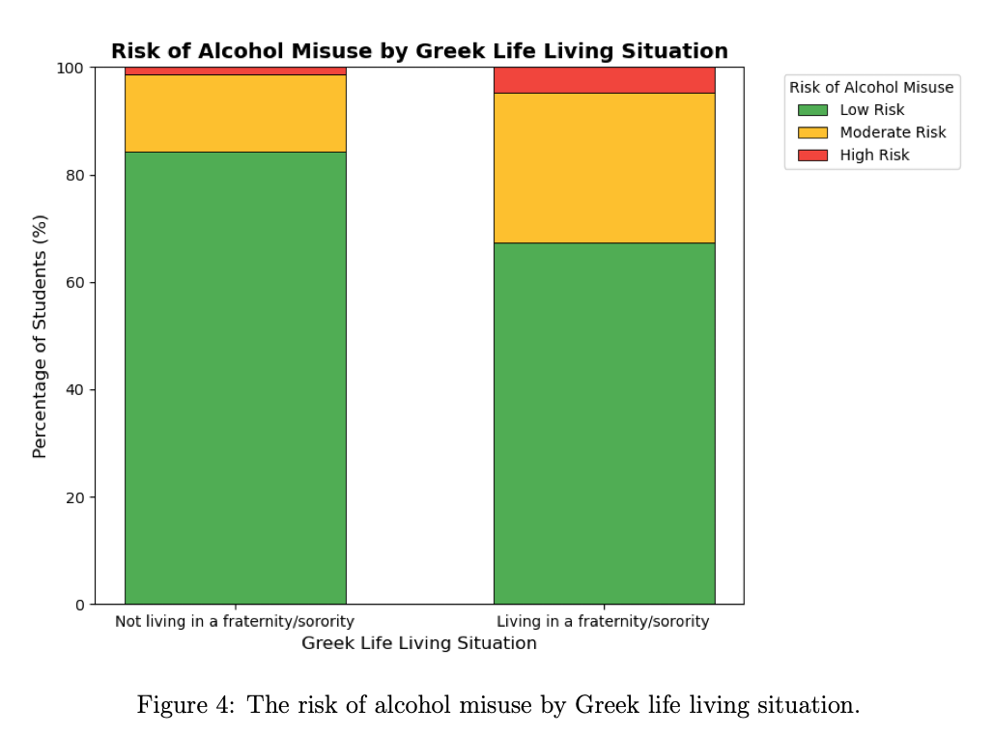
Methodology
(Data Analysis & Visualization)
Notes:
15.7% of students who do not live in Greek housing are in the moderate-to-high risk range of alcohol misuse
whereas 32.6% of students who do live in Greek housing are in this range
for students who answered that they simply participate in Greek life, this proportion was 26.4%
This highlights the importance of educating fraternity and sorority members on responsible alcohol consumption and associated behaviors, as these higher numbers apply to both those who are simply a member of the organization, and also those who live in the house itself.

Slide 21
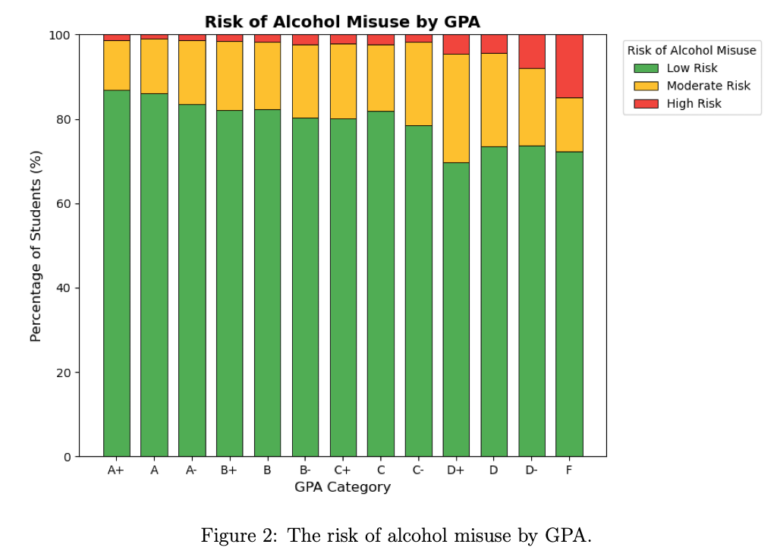
Methodology
(Data Analysis & Visualization)
Notes:
The risk of alcohol misuse increases as GPA decreases, signifying that students with lower GPA are more likely to be those with moderate-to-high alcohol risk.
There were no correlations between GPA and binge drinking or alcohol consumption rates, suggesting that frequency of drinking is less important to a student’s academic success
than the risk factors associated with drinking, as seen by the correlation between higher chances of misuse among students with lower GPAs.

Slide 22
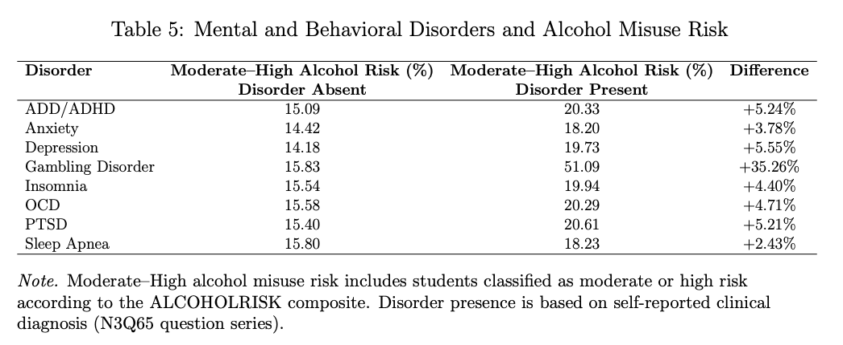
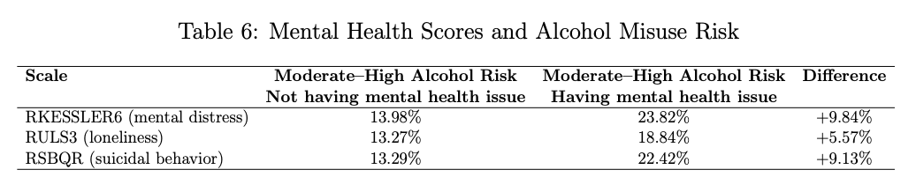
Methodology
(Data Analysis & Visualization)
Notes:
FIRST TABLE: If a student has at least one of any of these disorders, they are more likely to have a moderate-high risk of alcohol misuse than those without the same disorder (typically, around a 4.5-5% increase)
This is not causal, of course, as this is possibly a result of students with these disorders potentially drinking more often or having harmful drinking behaviors, which actually leads to the increased risk of alcohol use
Note that the abnormally large chance of alcohol misuse for students with a gambling disorder may be due to the sample size of that population, with it being only 162 students, while these other populations range from 2,394 students to 35,840.
SECOND TABLE: Comparing the results from table 5 to table 6, it currently seems that the presence of issues like mental distress and suicidal behavior are slightly more impactful on moderate to high alcohol misuse risk than the diagnosed mental disorders themselves (anxiety, depression, etc.)
Furthermore, however, are the DIENER and CDRISC2 scores. In both tables, there were no correlations with binge drinking rates

Slide 23
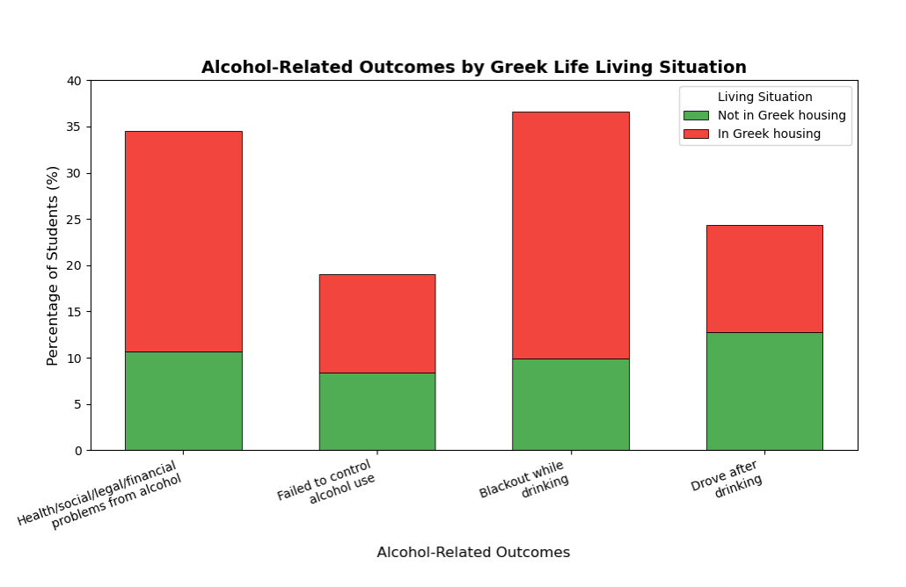
Methodology
(Data Analysis & Visualization)
+16.8%
+13.1%
-1.2%
+2.2%
Notes:
Students who live in Greek housing are significantly more likely to experience health, social, legal, and financial problems from alcohol, and are also significantly more likely to blackout when drinking, which comes with its own issues such as hindered cognitive abilities like worsened impulse control, judgment, and decision-making which leads to a greater chance of injuries and sexual assault.
However, in contrast, students in Greek housing actually drink and drive less than the rest of the college population.
All this to say that education on risks of blackout drinking and alcohol-related consequences is very important for those involved in Greek Life on a college campus.

Slide 24
Model Building & Testing
After performing exploratory data analysis (EDA) and visualization, the next step is building and testing a model
The EDA and visualization phase serve to lay out a foundation to build a more accurate and reliable model by revealing variable relationships

Slide 25
Model Building & Testing
The model created for this project was an ordinal logistic regression model
This decision was informed by the similar modeling processes in literature reviewed for this study and the choice to attempt to predict an ordinal outcome
A standard logistic regression model focuses on two outcomes, whereas ordinal logistic regression models handle outcomes with a natural order
The variable ALCOHOLRISK is the focus of the model, where the model will attempt to classify a student as having a low, moderate, or high risk of alcohol misuse based on a number of factors
Notes:
The majority of factors, or “predictors” were covered on slides 11 and 12 in the methodology section

Slide 26
Model Building & Testing
After choosing predictors, missing values were cleared from every predictor column that would be used
This reduced the size of the data to 58,933 rows, which is still large, and some columns were reformatted for consistency and modeling standards

Slide 27
Model Building & Testing
Additionally, two collinearity checks were performed to ensure that no variables had a prominent enough overlap to bias model results
If the collinearity checks failed, then principal component analysis would likely be required to eliminate collinearity
Principal component analysis (PCA) is a statistical technique used to reduce redundancy and noise among similar variables by combining them into new, artificial variables
Notes:
\

Slide 28
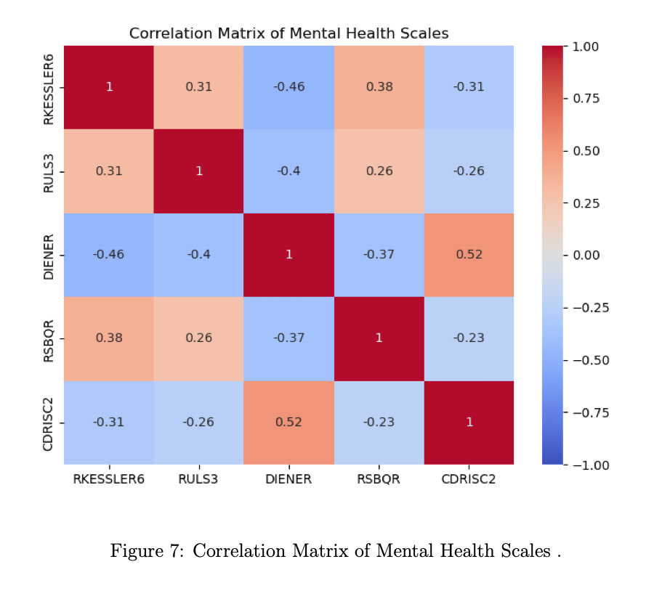
Model Building & Testing
Notes:
One of the collinearity tests is a correlation matrix which shows how much each variable is correlated to every other variable in a given group
This was performed for both mental health scales as well as mental health diagnoses, which make up a majority of the predictors
A score of 1 indicates perfect correlation between two variables and a score of 0 indicates no correlation two variables
The goal was to avoid scores above 0.7 or below -0.7 (because the scale goes to both sides of zero depending on how the variables interact)
For the diagnoses, the results were stable as well
Additionally, variance influence factors (VIF) were calculated were calculated for each of these variables
A score above 5 would be conventionally suggest high collinearity
The highest score was a 2.65 for anxiety, indicating again that there is only low-moderate collinearity present

Slide 29
Model Building & Testing
During the modeling process, data is split into two groups; one being the training split and the other being the testing split
75% of the data was used to train the model by teaching it patterns
25% was used to test the model by evaluating its accuracy on new unseen data

Slide 30
Model Building & Testing
Upon running the model, some outputs were produced that give insights into the model performance
The first of these is mean absolute error (MAE), which is the average size of the mistakes made by the model's predictions
The MAE score was 0.278, which indicates that, on average, the model's predictions were less than 0.3 categories off, where the jump from low to moderate risk (or moderate to high risk) is one category
Additionally, 98.7% of predictors were exact or only off by one category meaning that only 1.3% of the test data reflected the most severe misclassification
Notes:
The model demonstrates strong performance in maintaining the correct ordinal ranking of alcohol misuse risk, effectively capturing the relationships between predictors and risk levels; however, an imbalance in class sizes caused the model to predominantly group students into the low-risk category, thus limiting its sensitivity for precisely identifying moderate and high-risk individuals. TALK ABOUT HOW FEW PEOPLE WERE HIGH RISK EARLIER ETC

Slide 31
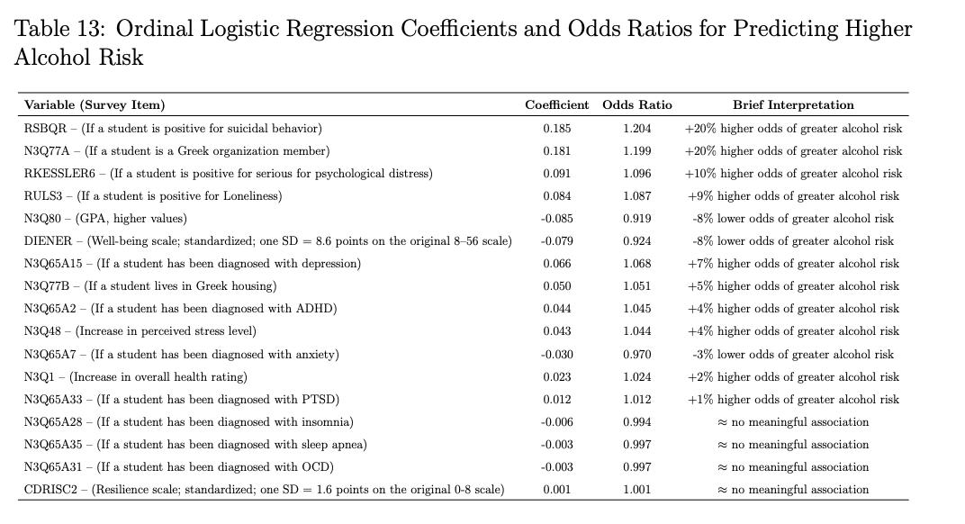
Model Building & Testing
(Logistic Regression)
Notes:
The odds ratios directly reflect the change in odds of being in a higher alcohol-risk category, not movement between specific adjacent categories, as the model does not
assume equal spacing between the categories
The percentage change in odds in the "Brief Interpretation" value is calculated by subtracting 1 from the odds ratio and multiplying the value by 100.
There were two variables who shared the same strongest impact on the model. Students who screened positive for suicidal behavior or who were involved in Greek life had approximately 20% higher odds of being in a higher alcohol-risk category. Students with SPD and those reporting loneliness also had increased odds (10% and 9%, respectively), while higher GPA was associated with lower risk, with each grade increase reducing the odds by about 8%. Several factors, including insomnia, sleep apnea, OCD diagnoses, and resilience scores, showed no significant effect. Notably, the model indicated four times greater odds of higher alcohol risk for Greek organization members compared to students living in Greek housing, which contrasts with findings from the exploratory data analysis.

Slide 32
Results & Discussion
The most impactful predictors of higher alcohol misuse risk are suicidal behavior and participation in Greek life
  Both factors align with previous literature
The presence of psychological distress, loneliness, a lower GPA, lower quality of life, and depression show moderate-to-strong predictive power on higher alcohol misuse risk as well
  These ideas are reinforced by many studies as well

Slide 33
Results & Discussion
The majority of general mental health issues were stronger predictors than the actual mental health diagnoses
  Suicidal behavior, psychological distress, loneliness, and lower quality of life had more impact on higher alcohol risk than any mental health diagnosis
The analysis phase showed Greek living situation to be more impactful, while the modeling phase showed Greek life participation to be more impactful
  Either way, this means that students who participate in Greek life need to be educated on the risks that alcohol misuse poses
In this model, insomnia, sleep apnea, OCD, and resilience had no predictive power on alcohol risk

Slide 34
Conclusion
This study evolved from a general investigation of alcohol-related issues into an effort of capturing relationships between predictors and alcohol misuse risk
The model, which had varied class sizes, produced a MAE of 0.278 and a within-1 value of 98.7%, indicating that the model performs better at capturing ordinal relationships than precisely identifying students in higher risk categories
Greek life participation/living showed strong correlation with and predictive power of higher alcohol risk
Mental health issues showed stronger predictive power than mental health diagnoses themselves, an issue sparsely discussed in previous literature
This study is especially important for students, institutions, and researchers, as it outlines efforts for future research and education on predictors and consequences of alcohol misuse

Slide 35
Connection to Ribbons of Excellence
Notes:
Caring for humanity and the world:
This project identifies key mental health and social risk factors for alcohol misuse among college students to support targeted prevention and student well-being.
Learning throughout a lifetime:
This project demonstrates intellectual growth by refining research questions and methods through literature review, exploratory analysis, and model development.
Thinking critically:
This project applies statistical reasoning to evaluate predictors of alcohol misuse risk while recognizing data limitations and model uncertainty.
Crossing boundaries and disciplines:
This project integrates public health, psychology, statistics, and education to better understand alcohol misuse in college populations.
Developing creativity:
This project uses creative data visualization and modeling choices to reveal patterns and inspire innovative approaches to alcohol misuse prevention.

Slide 36
Resources
.talk about on-campus resources and link online resources
.
.
.
.

Slide 37
References
S. R. Kenney, G. T. DiGuiseppi, M. K. Meisel, S. G. Balestrieri, and N. P. Barnett, “Poor mental health, peer drinking norms, and alcohol risk in a social network of first-year college students,” Addictive Behaviors, vol. 84, pp. 151–159, 2018
M. Rooney, A. Chronis-Tuscano, and Y. Yoon, “Substance use in college students with adhd,” Journal of attention disorders, vol. 16, no. 3, pp. 221–234, 2012.
A. Ay, C. C¸ am, A. Kılın¸c, M. F. ¨Ons¨uz, and S. Metinta¸s, “Prevalence of hazardous alcohol consumption and evaluation of associated factors in university students,” Social Psychiatry and Psychiatric Epidemiology, vol. 60, no. 2, pp. 223–233, 2025.
V. Lorant, P. Nicaise, V. E. Soto, and W. d’Hoore, “Alcohol drinking among college students: college responsibility for personal troubles,” BMC Public Health, vol. 13, pp. 1–9, 2013.
A. White and R. Hingson, “The burden of alcohol use: Excessive alcohol consumption and related consequences among college students,” Alcohol Research: Current Reviews, vol. 35, no. 2, p. 201, 2014.
Notes:
For more references, please refer to my report

Slide 38
Acknowledgements
I would like to thank...
My parents, Mike and Leslie Watson, for always supporting me and pushing me to strive for excellence
Dr. Yasser Alginahi, my project supervisor, for his mentorship, time, and support throughout this process
Adrian College, for providing research opportunities to inquisitve students
The ACHA, for providing the dataset used in this study
Notes:
THANK EVERYONE FOR COMING
AFTER QUESTIONS, INTODUCE ANTHONY “ “Finding the Net: A Predictive Look at NHL Shooting Performance” – Anthony Mollica”

